Slide 1

Affectiva AI and Cognitive Computing
Understanding the intersection of emotion recognition and artificial intelligence.
Presented by
Sahil Kularia (102316075)
Puranjay Salaria (102316084)

Slide 2

Introduction to Affectiva AI
Emotion Simulation
Multimodal Inputs
AI simulates human emotions and detects emotional states.
Uses facial expressions, voice tone, body language, physiological signals.
Enhanced Interaction
Bridges emotional intelligence with machine learning for better HCI.

Slide 3

What is Cognitive Computing?
Human Thought Simulation
Key Technologies
Includes machine learning, NLP, speech, and pattern recognition.
Solves complex problems by mimicking cognition.
Core Components
Learning, reasoning, perception, language understanding.

Slide 4
Relationship Between Affectiva AI and Cognitive Computing
Affective AI Focus
Cognitive Computing Scope
Example
Targets emotion detection and response within machines.
Broader AI that integrates reasoning and learning capabilities.
Empathetic chatbots enhance user experience with emotional insight.

Slide 5

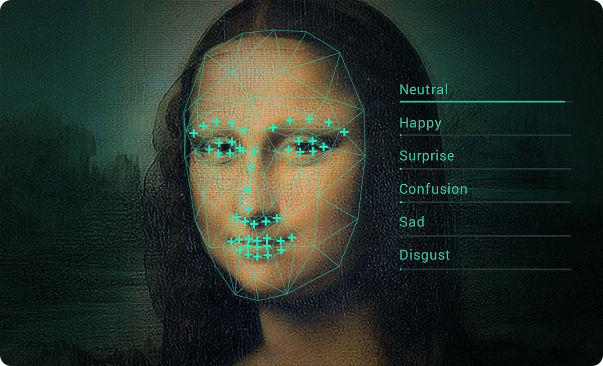



How Cognitive Computing Works in Affectiva AI
Data Processing
Collects emotional input from speech and facial cues.
Learning Patterns
Identifies and learns emotional patterns over time.
Adaptive Response
Changes AI behavior based on detected user emotions.

Slide 6






Techniques Used in Affective AI
Machine Learning
Detects emotional patterns through data analysis.
NLP
Analyzes emotional meaning in text and speech.
Computer Vision
Recognizes facial expressions and body language.
Speech Recognition
Extracts emotions from audio tone and pitch.

Slide 7




NLP in Affectiva AI
Sentiment Detection
Applications
Recognizes emotional tone in text and speech content.
1
Used in chatbots and mental health support bots.
2
Methods
Models
4
Sentiment analysis
Uses advanced language models like BERT and GPT.
3
Emotion detection
Topic modeling

Slide 8

Machine Learning in Affectiva AI
Supervised Learning
Unsupervised Learning
Trains on labeled emotional datasets for accuracy.
Discovers hidden emotion patterns without labels.
Deep Learning
Example
Uses neural networks to adapt emotions dynamically.
AI progressively adjusts to user emotions over time.

Slide 9

Real World Example of Affectiva AI
Affectiva AI powers empathetic chatbots enhancing customer experience.
These chatbots detect emotions via text and voice to respond appropriately.
Used in customer support to create more human-like, empathetic interactions.

Slide 10

Ethical Concerns and Challenges
Affective AI raises key ethical questions around privacy and bias.
Ensuring transparency and fairness is vital for trustworthy emotional AI.
Privacy Issues
Collecting emotional data risks user consent and data misuse.
Bias and Fairness
AI models may reflect and amplify existing social biases.
Transparency
Users need clear understanding of how emotions are analyzed.
Emotional Manipulation
AI could be misused to influence or manipulate user feelings.

Slide 11

Conclusion and Future of Affective AI
Affective AI is transforming how machines understand human emotions.
Advances promise more empathetic interactions across industries.
Future developments will focus on enhancing accuracy, ethics, and user trust.
Enhanced Emotional Intelligence
Responsible AI Use
Focus on transparency, privacy, and eliminating bias.
AI will better detect subtle emotions and contextual cues.
Broader Applications
Growth in mental health, education, and personalized experiences.

Slide 12
Thank You
We appreciate your attention and interest in Affectiva AI.
References include academic research, white papers, and industry reports on affective computing and AI ethics.
Key Sources
Industry Insights
Further Reading
Peer-reviewed journals on emotion AI and cognitive computing.
Reports from AI technology leaders and ethical AI frameworks.
Books and articles on affectiva computing applications and challenges.

